Slide 1
DATABASE DESIGN AND UI IMPLEMENTATION
MOHAMMED SHOEBUDDIN HABEEB
ANUSHA PALISETTY
NAVEEN KUMAR VADLAKONDA
CHAITANYA SAI KUMAR T
PRAGNA Reddy kancharla

Slide 2
INTRODUCTION :
One of the major industries which uses extensive Database management and application is Financial Sector.
As part of this project we would be introducing how customer account information maintenance and management is achieved through database in Banking applications.
This application will provide a platform to view and manage the financial transactions of the user related to bank
This database bridges the gap between customers and banking sector, where we would be able to maintain the bank and customer related data which can further be used in banking or web applications

Slide 3
DATA REQUIREMENTS:
Our database consists of total 27 tables and each table is identified with their respective primary key.
Major idea in data design is that a customer has an account in a branch of bank. This account should be able to do transactions, get a suitable loan when applied for and should be eligible for several perks(Benefit and Alerts) and can also be penalized.
We define Foreign keys based on the relationship between the all the major entities and their corresponding correlated entities
As this design is a customized and extensive Database we had to create our own Data which we made sure had proper relevance and followed all the intricate attribute requirements.

Slide 4
ER DESIGN
A branch is owned by bank. Branch manages account and employees bankers(employees)
Customer entity has relationships with Banker , Account, Loans and Cards
. Customer can apply for a max of 4 loans. Also a customer can have at most 20 accounts
An account table has relationship with Transactions, Penalty, Branch, customer and types of overlapping accounts.
Loans have an distinct specialization with Vehicle loan, home loan, personal loan and student loan
Similarly Cards have an overlapping specialization EMI, travel, corporate, Debit, credit and Loyalty card. This idea is also replicated for account
Customer gets benefits and alerts whereas account is penalized.

Slide 5
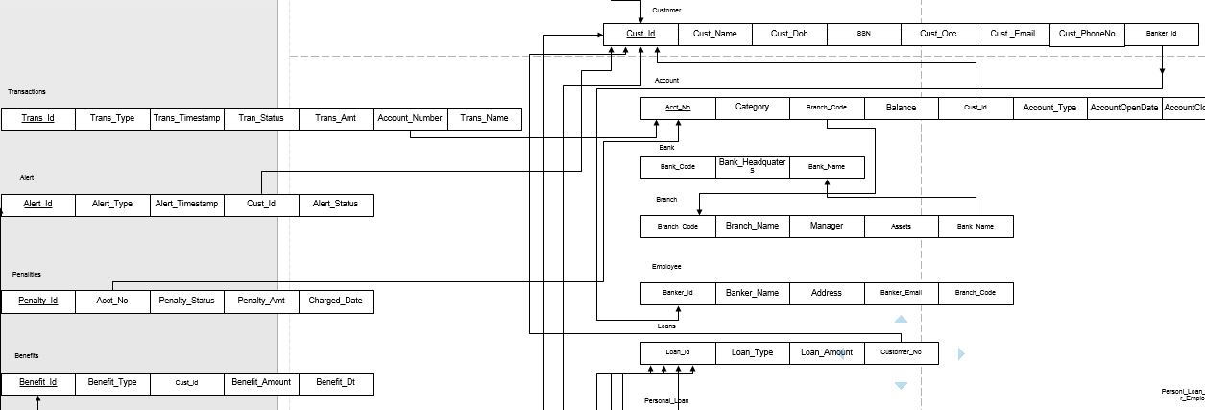
Relational Model:
Customer has Cust_ID which is linked with majority of tables
Employee, Branch and Transactions are some other significant attributes.
Mapping specialization and other info was done according to the heuristics in the book.
All the relations created already have 1NF. The 2NF and 3NF are implemented for based on this relational mapping. All the attributes are made sure they are dependent on the primary key and no non-prime attribute has transitive dependency on the primary key.
We had to add 2 new entities by splitting Cards and Personal Loans

Slide 6
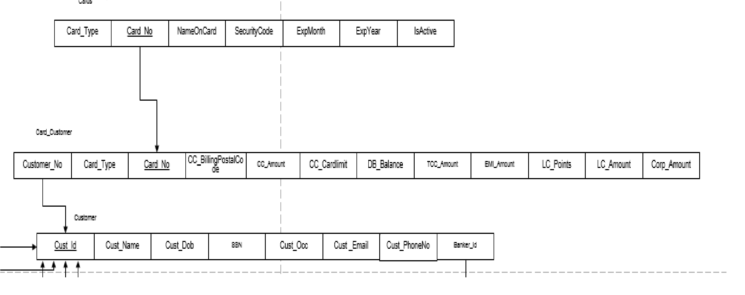
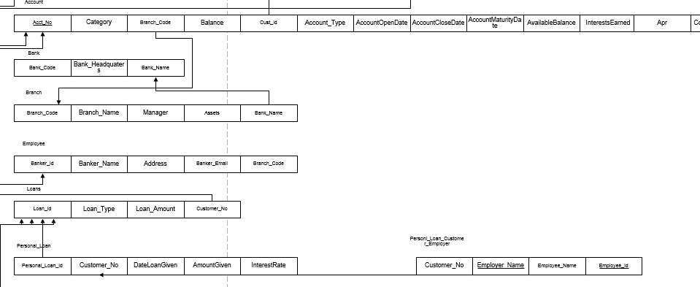
3NF challenges:
For the CARDS relation(Fig A) all the attributes dependent on the CARD_NO are included and the remaining attributes we split into CARDS_CUSTOMER which contains the attributes dependent on both CUST_ID and CARD_NO. Similarly for the Personal Loan (Fig B) the relation is split based on the functional dependency and 2NF. All the attributes which are dependent on Emplyer Name and Employee ID are in one relation and remaining attributes which dependends on both Personal_Loan_Id and Cust_Id have another relation. There no much cases where 3NF can be implemented as all the non-prime attributes are diretly dependent on the primary key
FIG A
FIG B

Slide 7
FUNCTIONAL REQUIREMENTS:
view
Account
Balances
Transfer
Amount from accounts
Update
Relationships
Loans
Transactions
Shows
Balances in account
Cards
Manage
Personal Account and Benefits

Slide 8
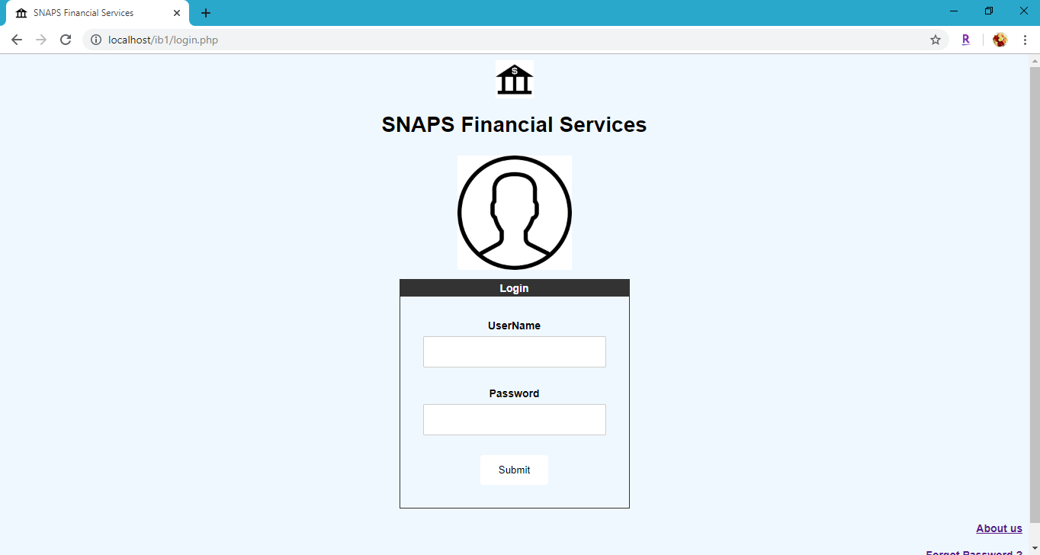
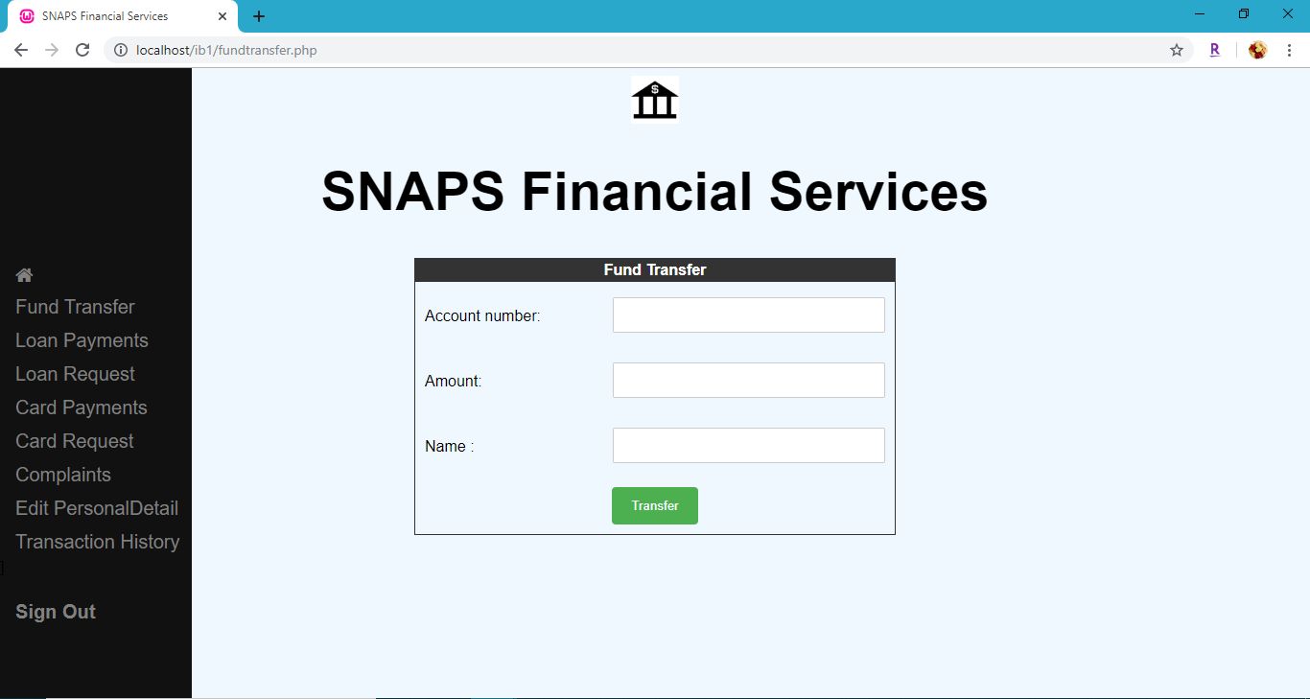
UI SCREENSHOTS : USER LOGIN

Slide 9
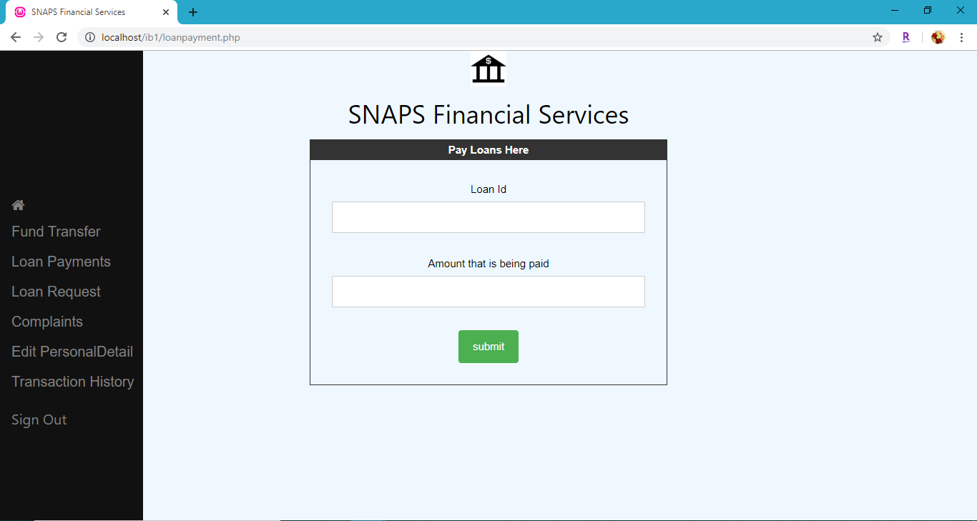
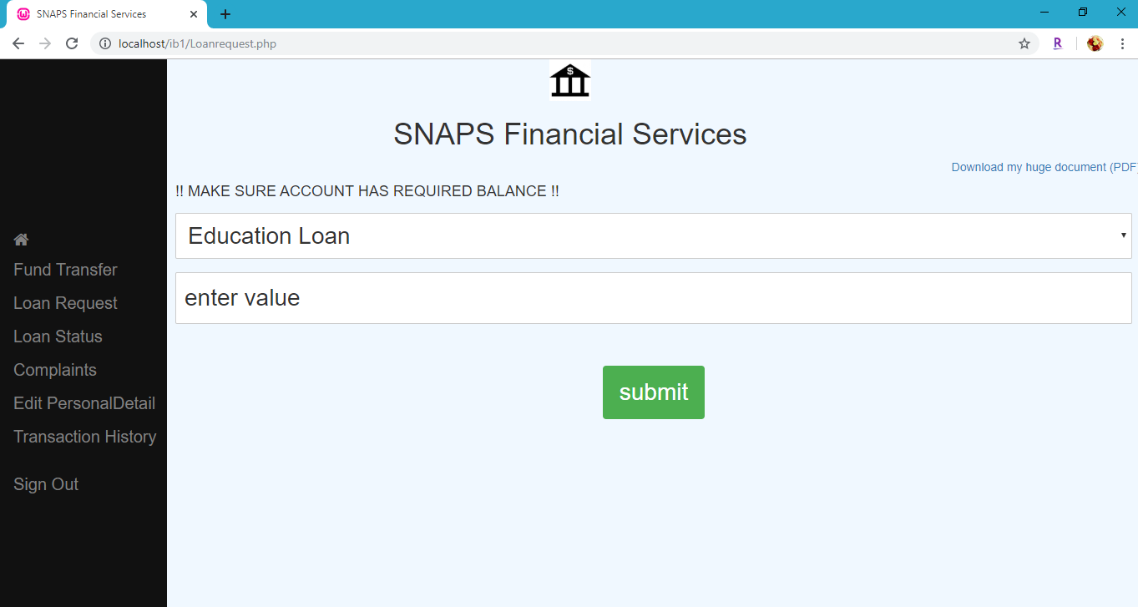
LOAN REQUEST AND PAYMENT

Slide 10

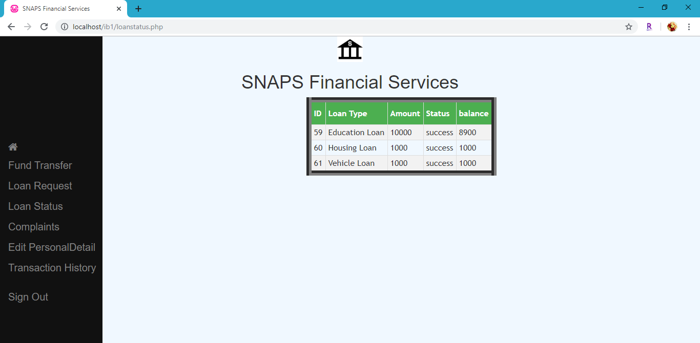
LOAN STATUS

Slide 11
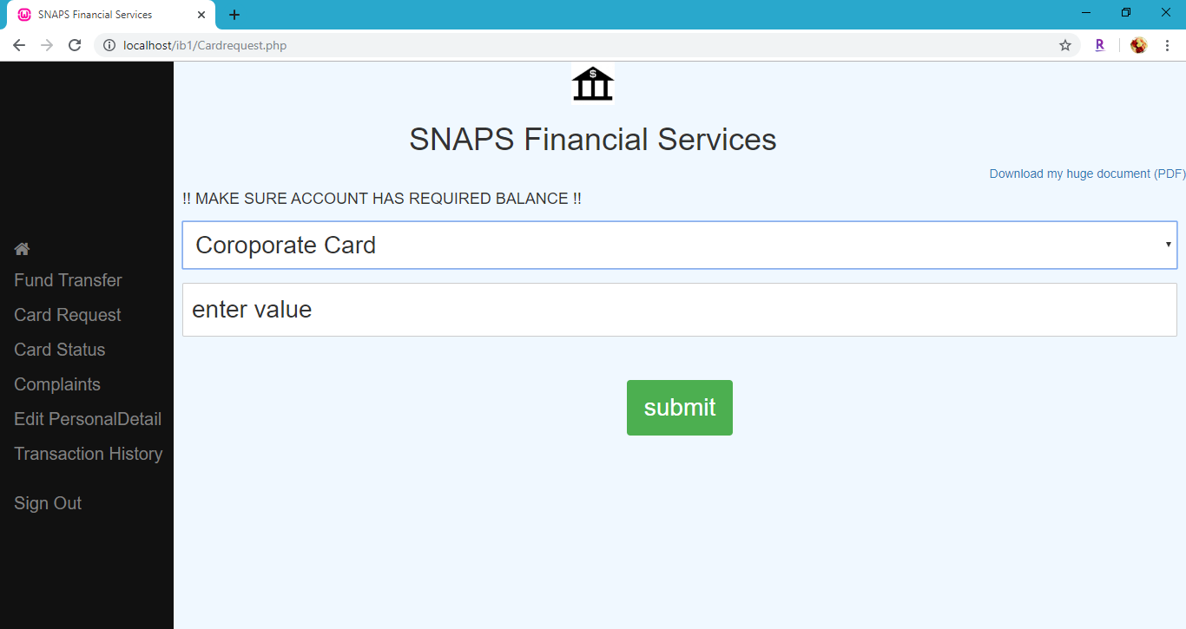

CARD REQUEST

Slide 12
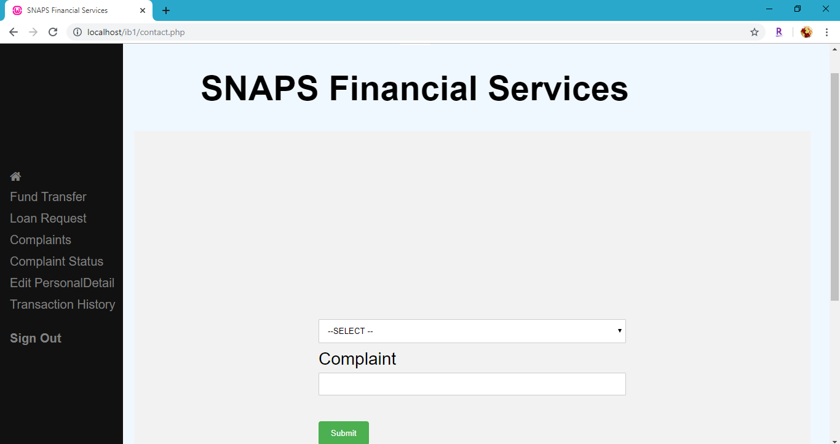
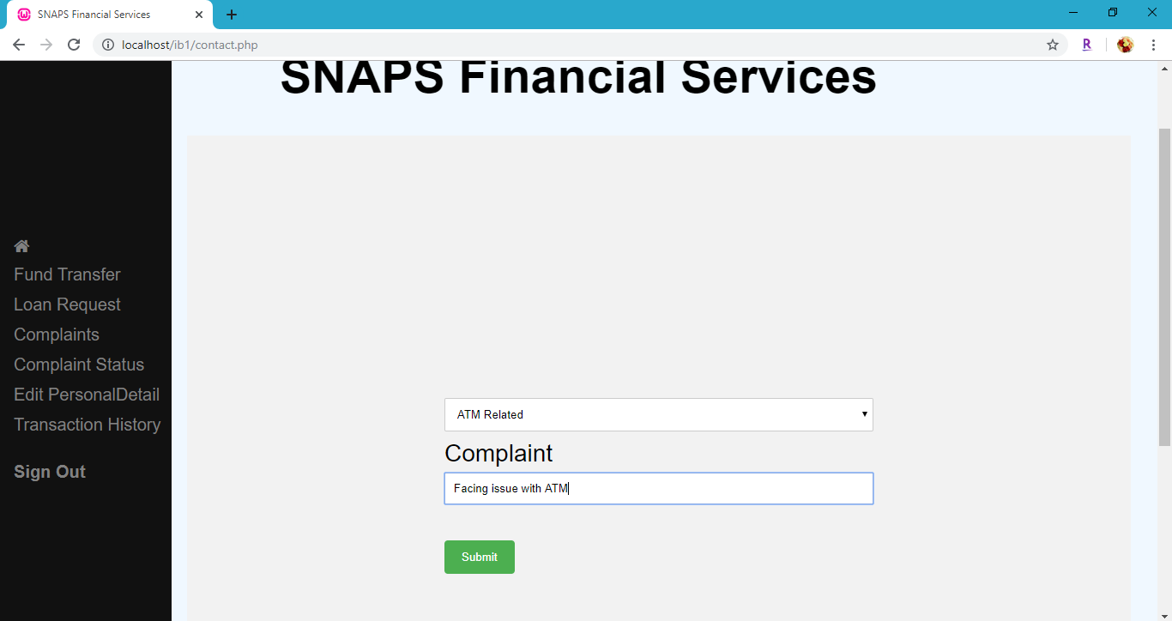
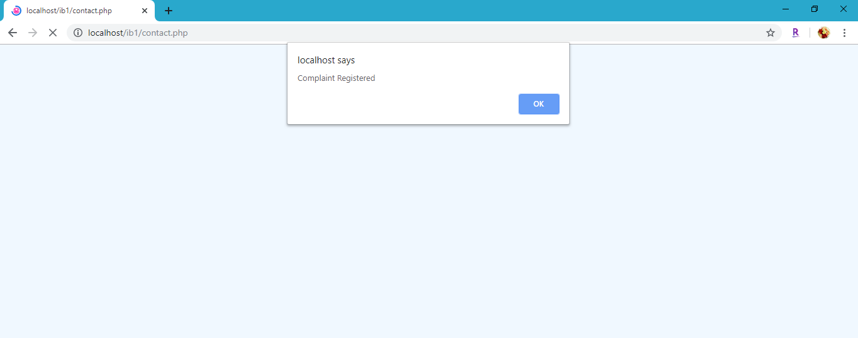
COMPLAINTS

Slide 13
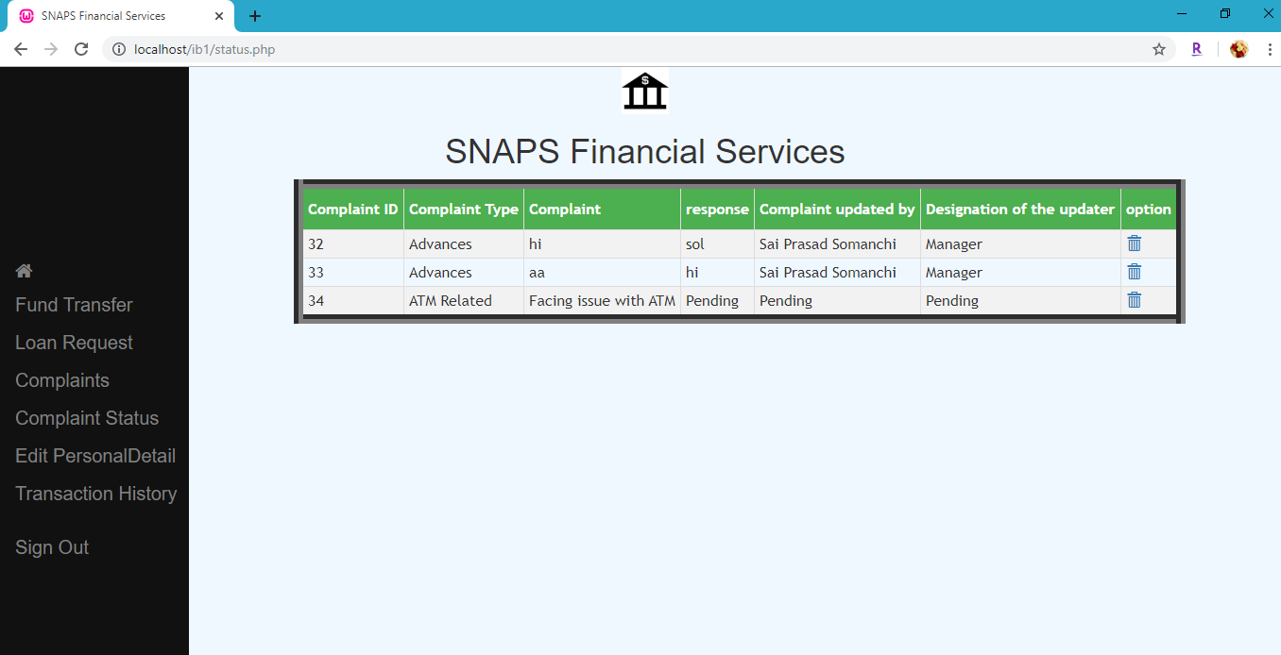
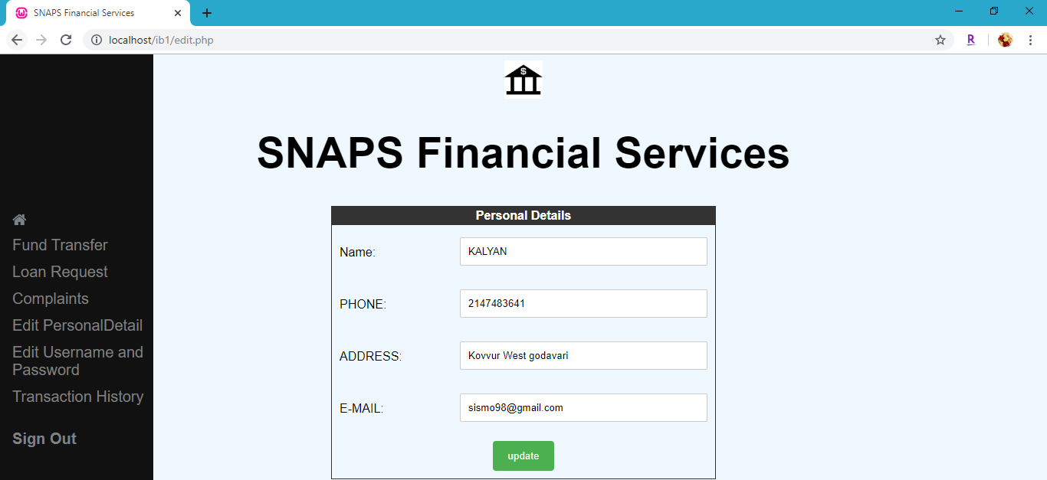
PERSONAL DETAILS

Slide 14
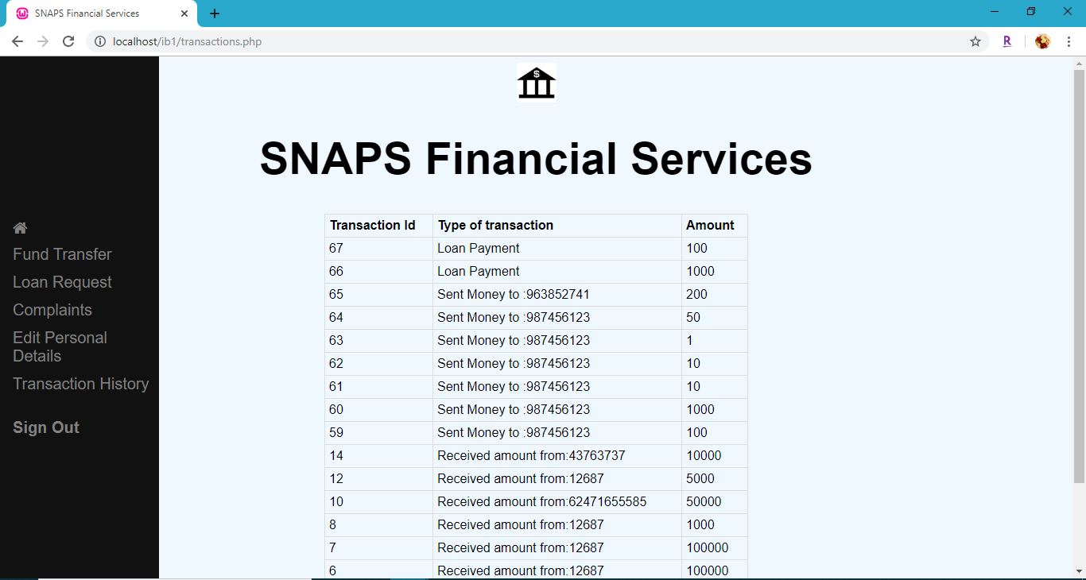
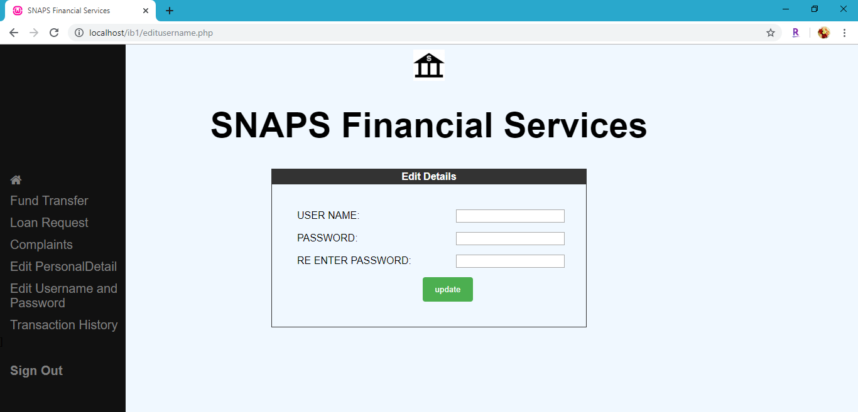
USERNAME AND TRANSACTIONS:

Slide 15
Key Findings and Conclusion
Learnings:
Difficulties
Conclusion
Handling and avoiding redundancy in a huge Database of almost 30 entities
Building a working UI right from a scratch
Understanding how each customer and account are mapped and linked
We decided to forego implementing BCNF as it could lead to complicated tables and decreases the understandability
Maintaining running suitable relationships often leads redundancy which could be a big problem when Database is huge
Keeping abstraction and encapsulation all the while maintaining an optimized DataBase requires extensive work and domain knowledge
Major Learning was when deciding attributes we wanted to cover all the major functionalities and this lead to a better understanding of types of categorical feature selection entries which go in building a DBMS model.

Slide 16
THANK YOU

